Slide 1

Micro-Credit Defaulter Model
-Pooja Mishra

Slide 2
Machine Learning can help lenders predict potential defaulters before approving their candidature using their past data records. In this presentation, we will be utilizing machine learning’s power to predict whether a borrower will default on a loan or not and to predict their probability of default in field of Telecom Industry.
Micro-Credit Defaulter Prediction

Slide 3
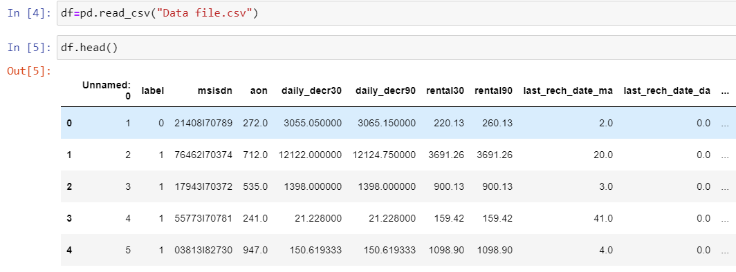
About Dataset
This dataset has been taken from Telecom Industry. It comprises 37 columns and 209593 rows. Here the target feature is ‘label’ where 0 indicates ‘defaulters’ and 1 indicates ‘non-defaulters’.
The dataset was imbalanced for the target feature(87.5% for Non-defaulters and 12.5% for Defaulters).
No Null Values present in this Dataset.
In this Dataset, there are total 37 columns in which the target feature is ‘label’.

Slide 4
Data Preprocessing
Dealing with Null Values: In this Dataset, there are no null values present.
In this Dataset, we have checked the outliers by plotting boxplot and removed outlier’s column by column by using IQR technique.
Here in this dataset, we observed that the columns we need to take ahead for modelling are in numeric. As 3 columns are not in numeric that we’ll remove later as its not contributing any important role in algorithm performance.
Here in this dataset, the columns which are not contributing to analysis are 'msisdn','pdate','balance_group','loan_frequency_group',’pcircle’ thus we’ll drop it.
We found values of numerical columns are not standard so for simplicity we use min-max scaler for all features.

Slide 5
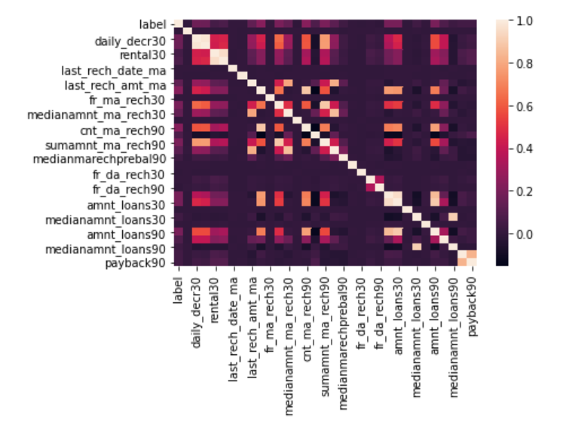
Correlation Matrix
Correlation Analysis:
Correlation analysis shows the correlation of target feature i.e. ‘label’ with all remaining features.
From this correlation graph we observed that few of the features are positively correlated, few are negatively correlated, and few features are not showing any correlation with target variable.

Slide 6
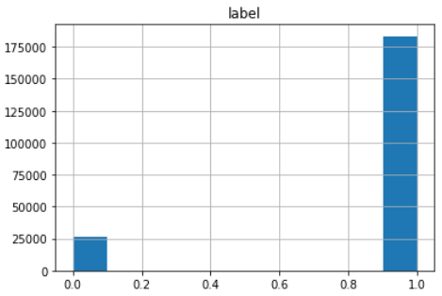
Data Visualization
Data Visualization On visualizing data, there were two important insights I gathered. a. Imbalance of data b. Distribution was not normal.
Univariant Analysis
From above graph we observed that Label ‘1’ i.e. Non-Defaulter has
approximately 87.5% records, while, label ‘0’ i.e.Defaulters has
approximately 12.5% records.

Slide 7
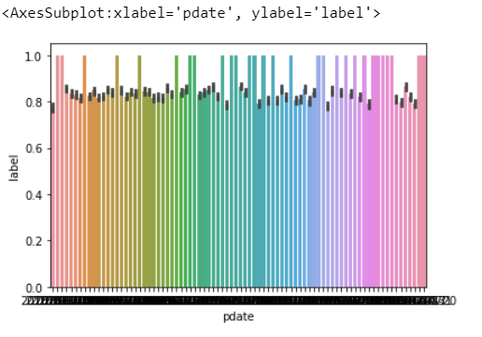
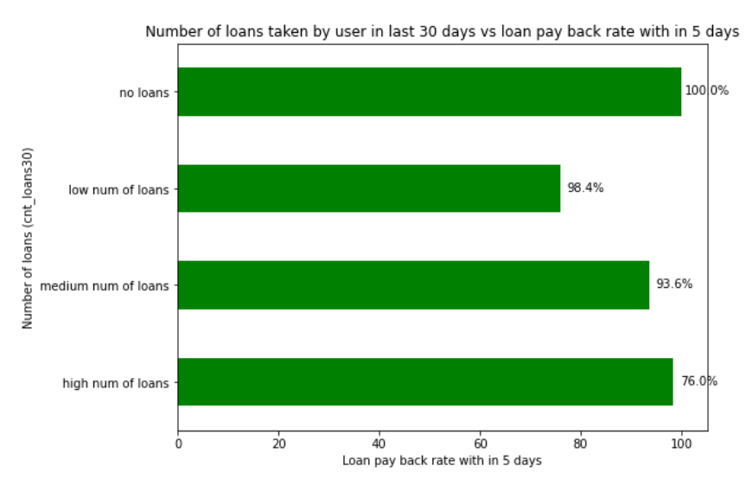
The above bar plot infers us how customers with The above bar plot shows how customers with The above bar graphs shows us how different loans levels taken are paying back the loan within five days. In the data set people not taken loans are labelled as ‘1’. So we should not consider the people with no loans labelled in the above graph.

Slide 8
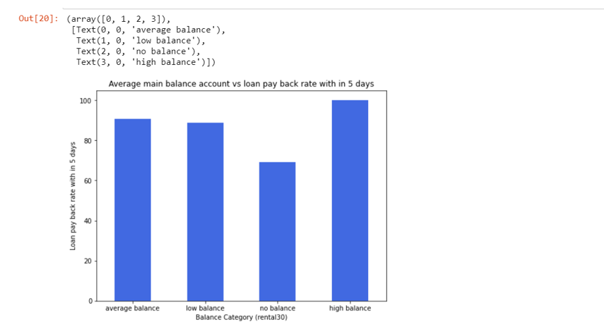
Average main Balance account Vs Loan payback within 5 days.
With this plot graph we observed that the high balance level people are 100% who are loan within 5 days. The people with average balance and low balance are around 90% who are paying loan within 5 days and 10-12% who are paying the loan within 5 days. The people with no balance are around 30% who are not able to pay loan

Slide 9
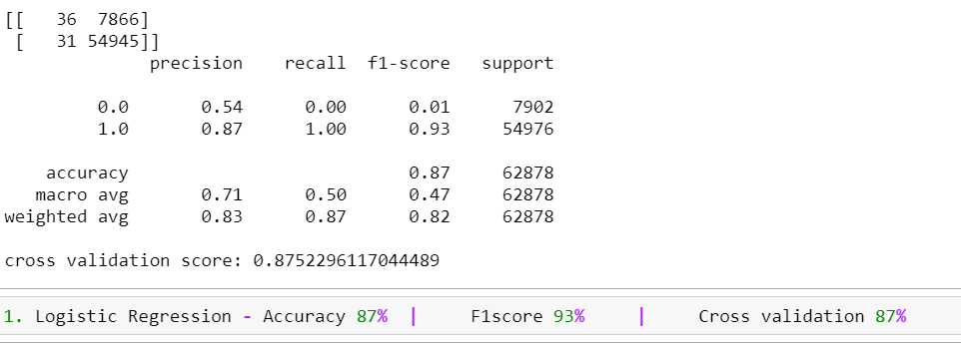
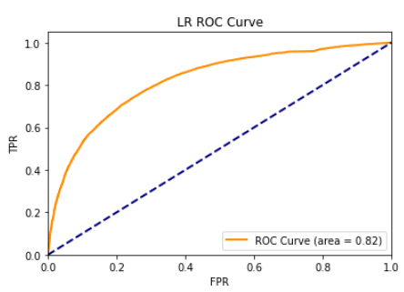
Model Development & Evaluation
1) Logistic Regression

Slide 10
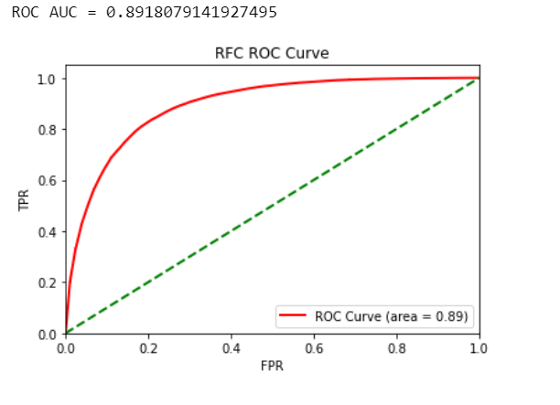
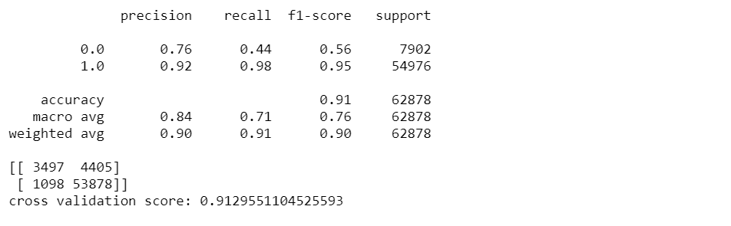
2) Random Forest Classifier

Slide 11
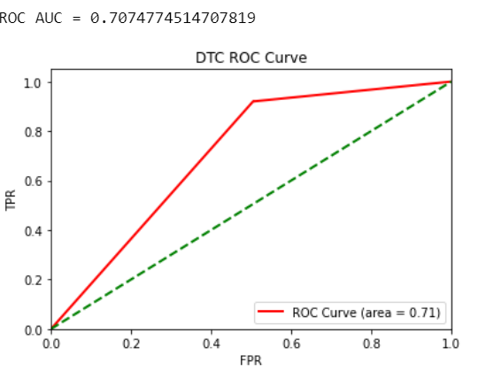
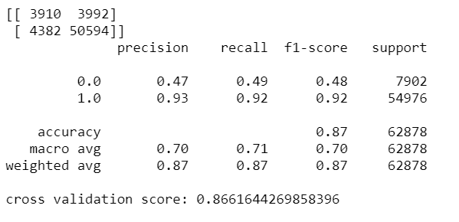
3) Decision Tree Classifier

Slide 12
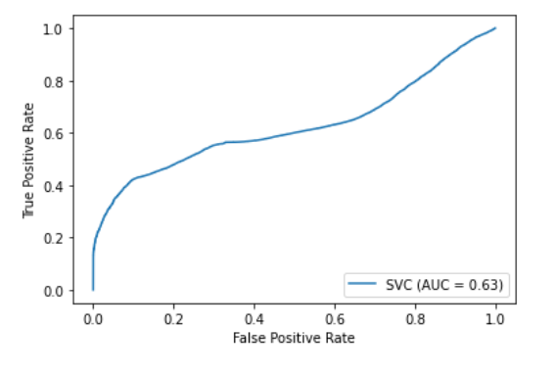
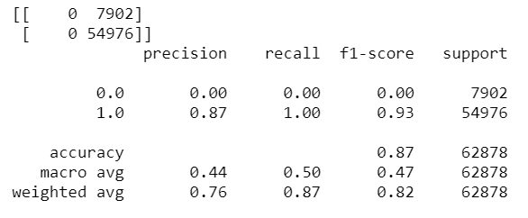
4) Linear Support Vector Machine

Slide 13
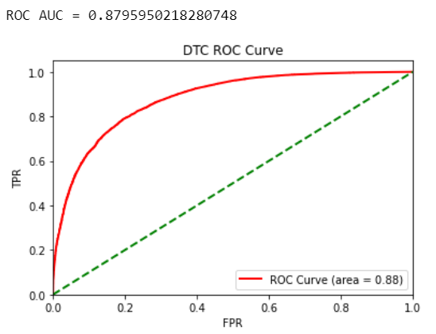
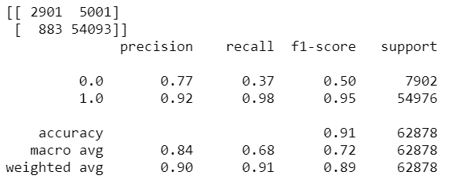
5) Gradient Boost Classifier

Slide 14
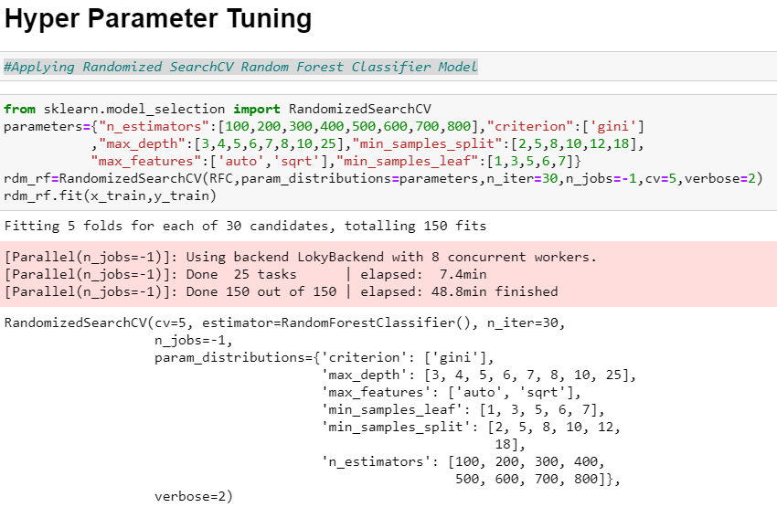
Hyper Parameter Tuning
We have performed Randomized Search to narrow down the possibilities to re-check the accuracy of this model so that we can conclude that Random Forest is the best fit model for this problem. This approach is more suited to get the best model selection confirmation.

Slide 15
Conclusion
According to the performance metrics, on all 5 metrics, Random Forrest scores highest in accuracy. From the result it is observed that all the metrics accuracy, precision, recall and f1-score are good.
Also, the curve is tending towards the ideal shape. Hence, Random Forrest looks like the best fit for this data.

